Slide 1


SUBMARINE
Silent Depths

Slide 2
Outline
What is a Submarine
Operations
Technologies used for Navigation
Inner & Outer Workings
Indian Navy Submarines

Slide 3
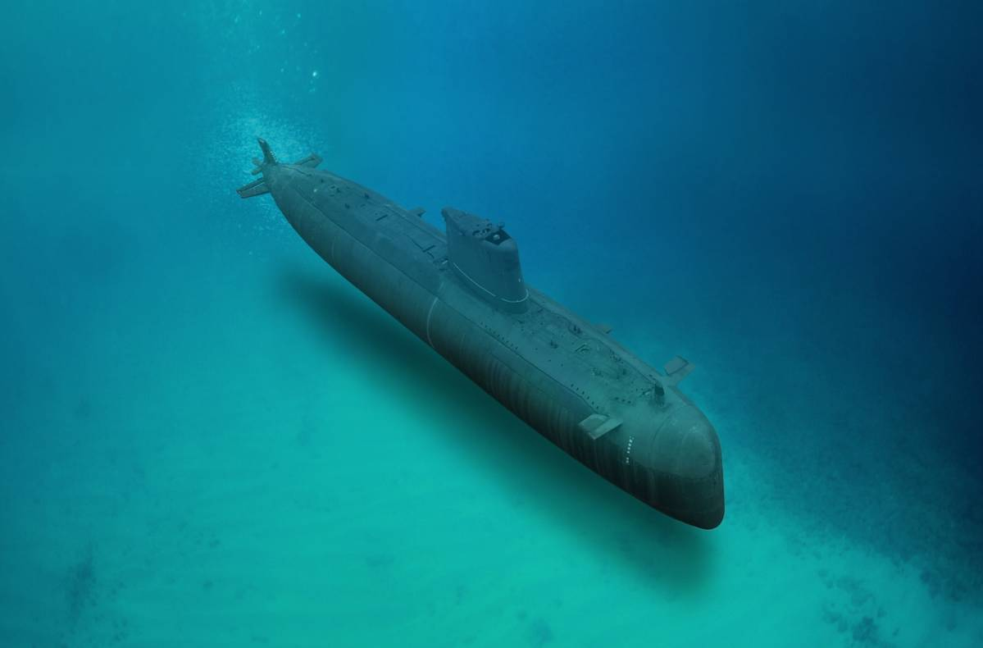
WHAT IS A SUBMARINE
A submarine is a vessel or special kind of ship that has the ability to go underwater. It looks quite like a huge whale.
There are basically three types of submarines
Military Submarines
Research Submarines
Tourism Submarines

Slide 4
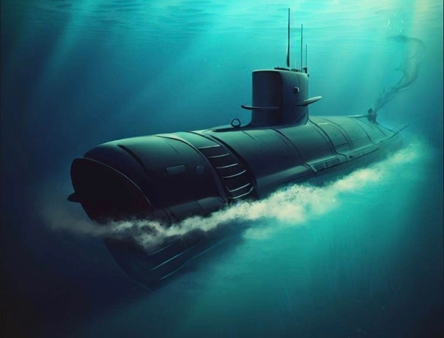

Slide 5
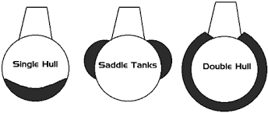
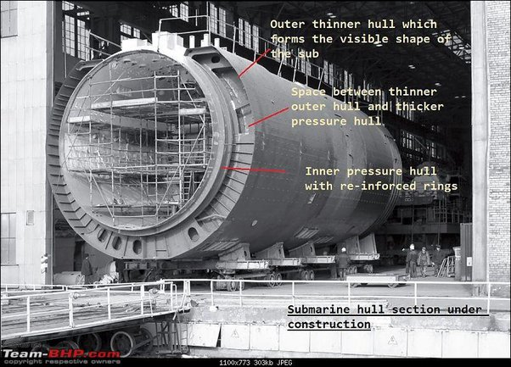
OPERATIONS

Slide 6
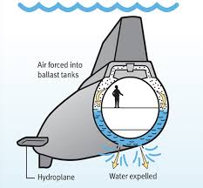
OPERATIONS
1. Buoyancy Control : The submarine uses ballast tanks to manage its buoyancy.
2.Movement and Steering : Hydroplanes on the stern control the angle of the dive, while the tail rudder steers the submarine to the right (starboard) or left (port).
3. Life Support and Air Supply : Compressed air is stored in air flasks aboard the submarine for life support and to be used with the ballast tanks.

Slide 7
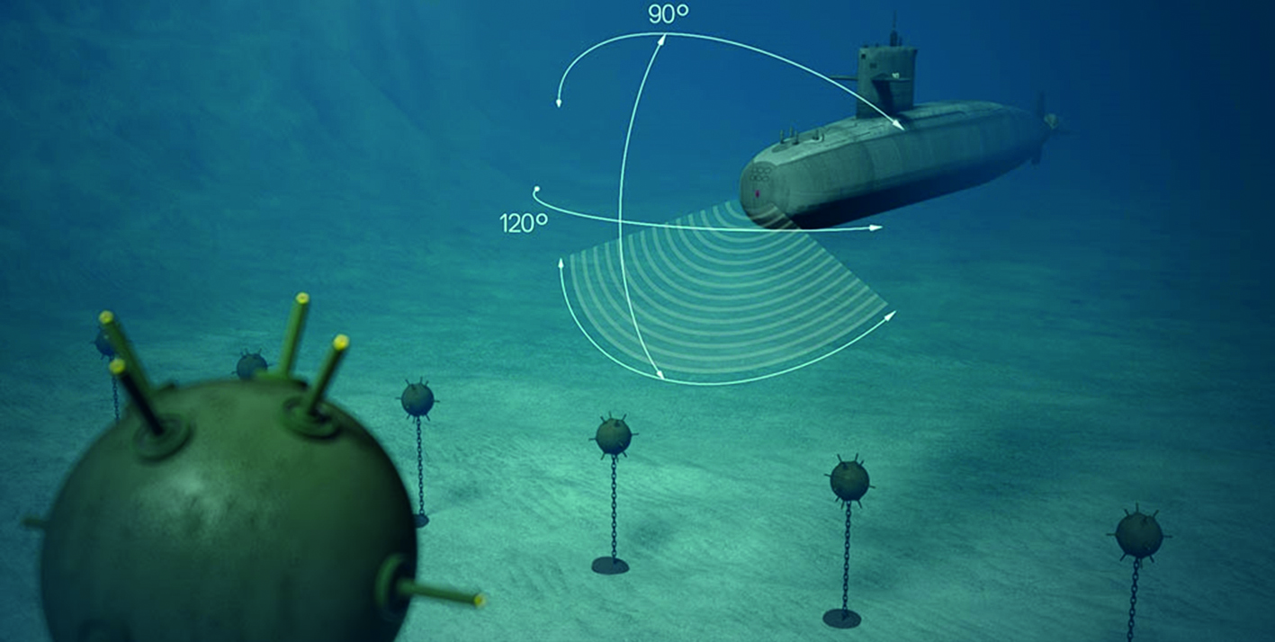
Sound Navigation And Ranging
[SONAR]
Active Sonar
Active sonar emits sound pulses into the water and listens for echoes that return after bouncing off objects. This system helps submarines determine the location, distance, and movement of underwater objects or vessels.
Passive Sonar
Passive sonar listens for sounds made by other vessels or underwater objects without emitting any sound waves. This method allows submarines to gather information while maintaining stealth.

Slide 8
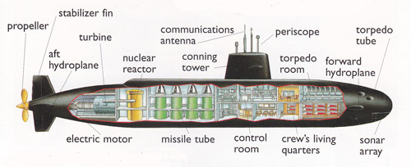

Slide 9
Indian Navy Submarines
The Indian Navy operates submarines from four main classes, each serving different purposes and capabilities:
1. Kalvari Class(5) : Diesel-electric attack submarines based on the Scorpène-class design. Used for anti-submarine warfare, anti-surface warfare, intelligence gathering, mine laying, and area surveillance.
2. Sindhughosh Class(7) : Diesel-electric attack submarines, a variant of the Russian Kilo-class. Mainly used for anti-submarine warfare and intelligence gathering.
3. Shishumar Class (4): Diesel-electric attack submarines based on the German Type 209 design. Used for anti-submarine warfare, anti-surface warfare, intelligence gathering, and patrol missions.
4. Arihant Class(2) : Nuclear-powered ballistic missile submarines (SSBNs), India's first indigenous design.

